Slide 1


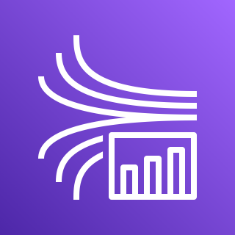


AWS Cloud – US-East-1
Amazon SageMaker Studio
Amazon Kinesis
Data Streams
Amazon Kinesis
Data Analytics
Amazon Kinesis
Data Firehose
Amazon Simple Storage Service (Amazon S3)

